Slide 1
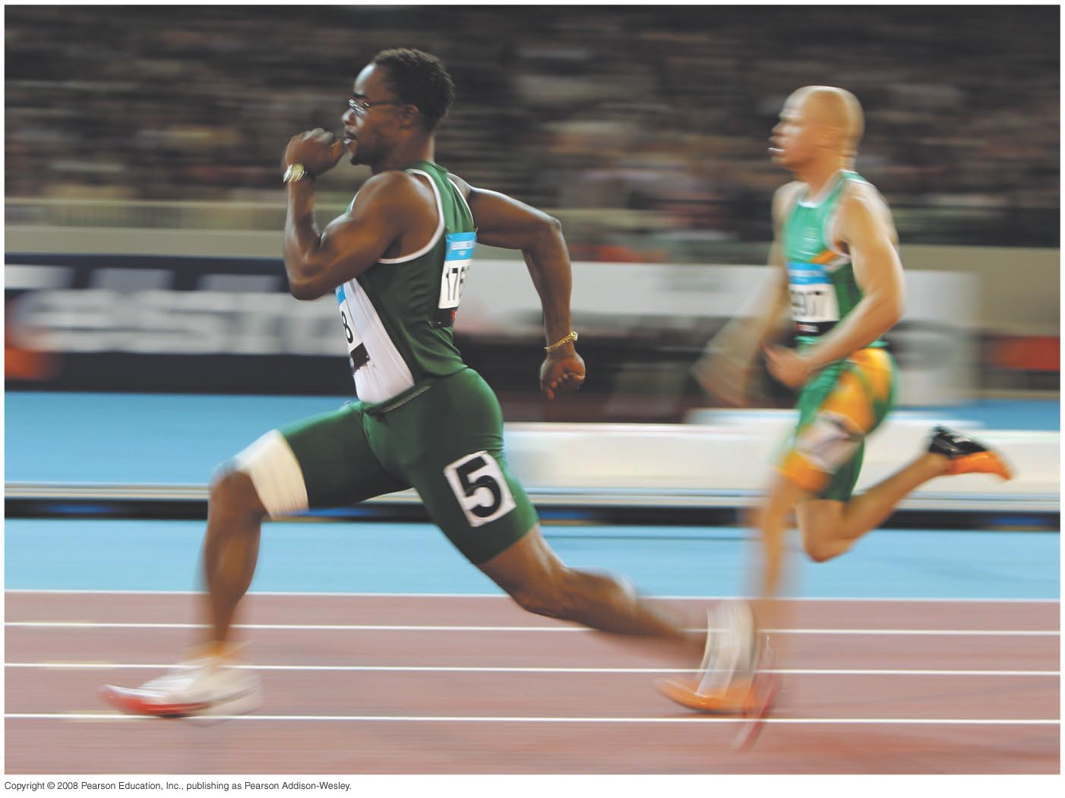

Chapter 2
Motion Along a Straight Line
University Physics 13th edition (Young and Freedman)

Slide 2
Mechanics
the study of the relationship among force, matter, and motion
MECHANICS
Kinematics
Dynamics
HOW an object moves
WHAT makes an object move

Slide 3
Which one moved?
Was it the clock? Or the table?

Slide 4
What is Motion?
reference point: YOU

Slide 5
What is Motion?
The CLOCK moved!!!

Slide 6
What is Motion?
reference point: still YOU

Slide 7
What is Motion?
The TABLE moved!!!

Slide 8
What is Motion?

Slide 9
What is Motion?
The CLOCK moved!!!
The CLOCK moved!!!

Slide 10
What is Motion?

Slide 11
What is Motion?
The CLOCK moved!!!
The TABLE moved!!!
Motion is RELATIVE!

Slide 12
The Position Vector (3D)
y
P
position vector
x
O
z

Slide 13
The Position Vector (2D)
y
P
position vector
x
O

Slide 14
The Position Vector (2D)
y
P_{i}
P
P_{f}
x
O

Slide 15
The Displacement Vector (2D)
y
P_{i}
P
P_{f}
displacement vector
x
O
displacement = change in position

Slide 16
The Position Vector (1D)
P_{i}
P_{f}
x
O
x_{i}
x_{f}

Slide 17
The Position Vector (1D)
P_{i}
P_{f}
x
O
10 m
23 m
displacement Δx = x_{f} – x_{i} = (23 m) – (10 m) = 13 m

Slide 18
The Position Vector (1D)
P_{f}
P_{i}
x
O
–13 m
10 m
displacement Δx = x_{f} – x_{i} = (–13 m) – (10 m) = –23 m

Slide 19
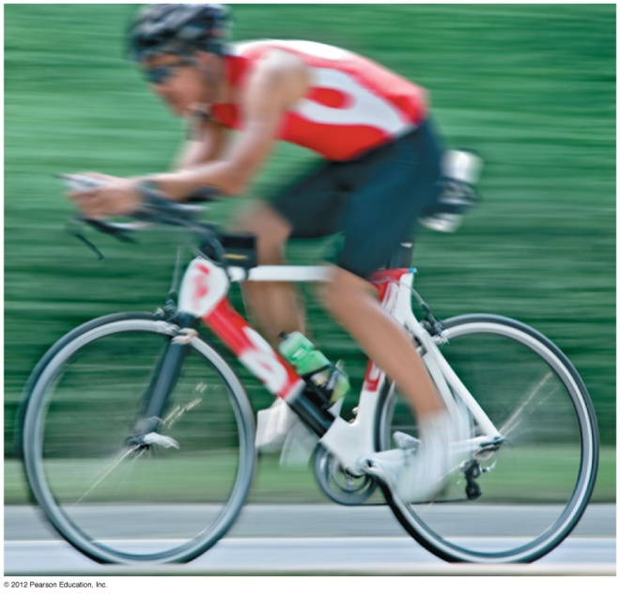
Displacement, Time, and Speed
Speed
tells you
how fast an
object moves.

Slide 20
Velocity: Speed with Direction
Average velocity

Slide 21
Average Velocity
P₁
P₂
x
x
O

Slide 22
Average Velocity
P₁
P₂
x
x
O
90 m
18 m
72 m
18 m
90 m

Slide 23
Average Velocity

Slide 24
Average Velocity
P₁
P₂
x
x
O
Notes:
That was for the positive (forward) direction. Now, how would we describe the velocity… … …

Slide 25
Average Velocity
P₂
P₁
x
x
O
18 m
90 m
Notes:
… … …when the object is moving back towards the negative direction? (Note the change in subscripts.)

Slide 26
Average Velocity

Slide 27
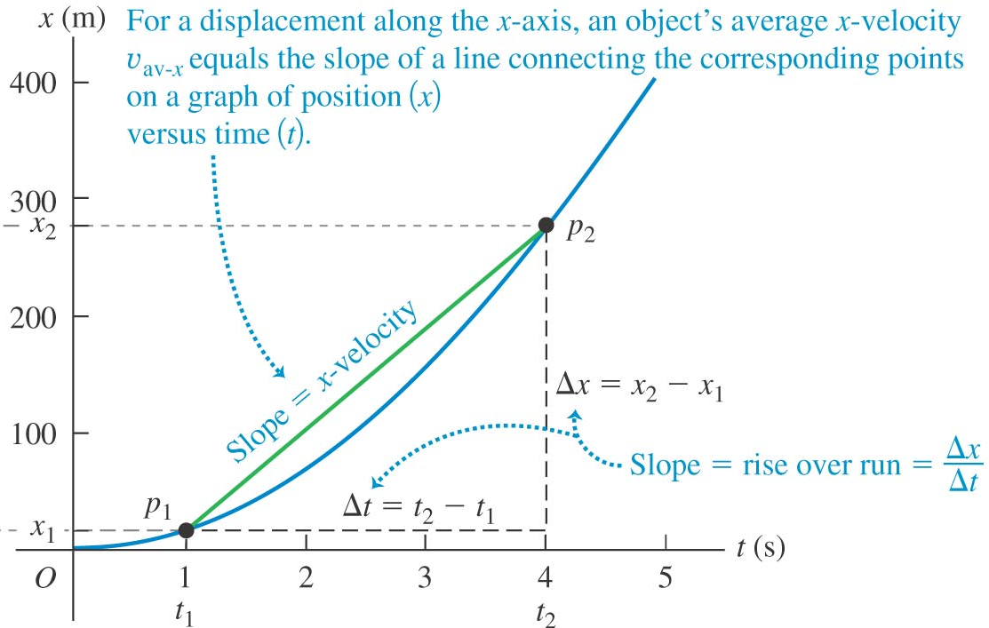
Average Velocity in a Position-Time Graph (x-t graph)

Slide 28
Example: Motion of a Rocket
A rocket carrying a satellite is accelerating straight up from the earth’s surface. At 1.15 s after liftoff, the rocket clears the top of its launch platform, 63m above the ground. After an additional 4.75 s, it is 1.00 km above the ground. Calculate the magnitude of the average velocity of the rocket for (a) the 4.75-s part of its flight and (b) the first 5.90 s of its flight.

Slide 29
Example: Motion of a Rocket
y₂ = 1000 m
a) For the 4.75-s part of the flight
t₂ = 1.15 s + 4.75 s
b) For the first 5.90 s of its flight
y₁ = 63m
t₁ = 1.15 s
y₀ = 0 m
t₀ = 0 s

